Slide 1


Lectures 6 - 7 1.Nested loops 2. Arrays 3. Multi-dimension arrays
PROGRAMMING 1
(CS 102)
6-7
Fall (2025-2026)

Slide 2
Course Learning Objectives
Explain and define fundamental programming concepts, including variables, data types, the sequential nature of program execution, and basic program input/output (I/O).
Trace and debug simple programs to identify and correct basic syntax and logical errors.
Apply basic programing concepts, such as conditional statements, loops, and functions, to solve small scale computational problems.
Decompose problems into smaller, manageable subroutines, and implement basic functions to enhance code modularity and reusability.
Collaborate with peers Work in a team to design and implement a software project that meets specific functional requirements.

Slide 3

Lecture 6(Update) : arrays
Content
Nested Loops
Arrays
Multi-dimension Arrays

Slide 4
Nested Loops
Example: what is the output?
for (int i = 1; i <= 2; ++i) {
cout << "Outer: " << i << endl;
for (int j = 1; j <= 3; ++j) {
cout << " Inner: " << j << endl;
}
}
Outer: 1
Inner: 1
Inner: 2
Inner: 3
Outer: 2
Inner: 1
Inner: 2
Inner: 3

Slide 5
Practice
Example : Find errors.
int main() {
int x = 10.5;
cout << "x = " << x << endl;
return 0;
}
int main() {
while (i < 10) { cout << i *2<< "\n"; }
return 0;
}
int main() {
int a = 5, b = 3;
if (a = b)
cout << "Equal";
else
cout << "Not Equal";
return 0;
}
int main() {
for (int i = 10; i >= 5; i++)
{ cout << i << "\n"; }
return 0;
}

Slide 6
1. Arrays
C++ has a data structure called Arrays.
Arrays are used to store multiple values in a single variable, instead of declaring separate variables for each value.
Array: Data structure that maintains a collection of data elements of the same type.
Advantages of arrays over individual variables:
Arrays allow you to use loops and other techniques that are essential when dealing with large amounts of data. for example allow you to do fast searching and sorting.
5
6
8
20
50
91

Slide 7
1. Arrays
To declare an array, define the variable type, specify the name of the array followed by square brackets and specify the number of elements it should store:
Data_type Array_name[size];
int A[10];
We have now declared a variable that holds an array of four strings.
To insert values to it, we can use an array literal - place the values in a comma-separated list, inside curly braces:
string cars[4] = {"Volvo", "BMW", "Ford", "Mazda"};

Slide 8
2. Access the Elements of an Array
You access an array element by referring to the index number inside square brackets [ ].
This statement accesses the value of the first element in cars:
Example:
cars[0]
Volvo
BMW
Ford
Mazda
cars[1]
cars[2]
string cars[4] = {"Volvo", "BMW", "Ford", "Mazda"}; cout << cars[0]; // Outputs Volvo
cars[3]
Volvo
Note: Array indexes start with 0: [0] is the first element. [1] is the second element, etc.

Slide 9
3. Change an Array Element
To change the value of a specific element, refer to the index number:
Example:
cars[0] = "Opel";
Volvo
BMW
Ford
Mazda
string cars[4] = {"Volvo", "BMW", "Ford", "Mazda"}; cars[0] = "Opel"; cout << cars[0]; // Now outputs Opel instead of Volvo
Opel
BMW
Ford
Mazda

Slide 10
4. C++ Arrays and Loops
You can loop through the array elements with the for loop.
The following example outputs all elements in the cars array:
string cars[4] = {"Volvo", "BMW", "Ford", "Mazda"}; for (int i = 0; i < 4; i++) { cout << cars[i] << "\n";}
The following example outputs the index of each element together with its value:
string cars[4] = {"Volvo", "BMW", "Ford", "Mazda"}; for (int i = 0; i < 4; i++) { cout << i << ": " << cars[i] << "\n";}

Slide 11
5. Omit Array Size
If you specify the size however, the array will reserve the extra space:
Now you can add a fourth and fifth element without overwriting the others:
// size of array is 5, even though it's only three elements inside it
string cars[5] = {"Volvo", "BMW", "Ford"};
cars[3] = "Mazda"; cars[4] = "Tesla";

Slide 12
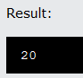
6. Get the Size of an Array
To get the size of an array, you can use the sizeof() operator:
Example:
Why did the result show 20 instead of 5, when the array contains 5 elements?
It is because the sizeof() operator returns the size of a type in bytes.
You learned from the Data Types chapter that an int type is usually 4 bytes, so from the example above, 4 x 5 (4 bytes x 5 elements) = 20 bytes.
int myNumbers[5] = {10, 20, 30, 40, 50}; cout << sizeof(myNumbers);
Q: give the output
int myNumbers[5] = {10, 20, 30, 40, 50}; int getArrayLength = sizeof(myNumbers) / sizeof(int); cout << getArrayLength;

Slide 13
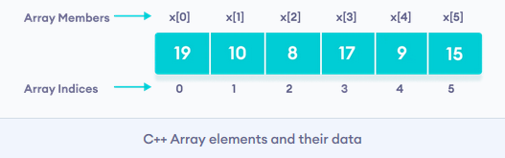
7. C++ Array Initialization
In C++, it's possible to initialize an array during declaration.
For example,
// declare and initialize and array
int x[6] = {19, 10, 8, 17, 9, 15};
Another method to initialize array during declaration:
Here, we have not mentioned the size of the array. In such cases, the compiler automatically computes the size.
// declare and initialize an array
int x[ ] = {19, 10, 8, 17, 9, 15};

Slide 14
8. How to insert and print array elements?
int mark[5] = {19, 10, 8, 17, 9}
// change 4th element to 9
mark[3] = 9;
// take input from the user
// store the value at third position
cin >> mark[2];
// take input from the user
// insert at ith position
cin >> mark[i-1];
// print first element of the array
cout << mark[0];
// print ith element of the array
cout >> mark[i-1];

Slide 15
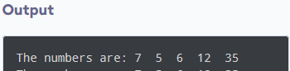
Example 1: Displaying Array Elements
#include <iostream>
using namespace std;
int main() {
int numbers[5] = {7, 5, 6, 12, 35};
cout << "The numbers are: ";
// Printing array elements
for (int i = 0; i < 5; ++i) {
cout << numbers[i] << " ";
}
return 0;
}

Slide 16
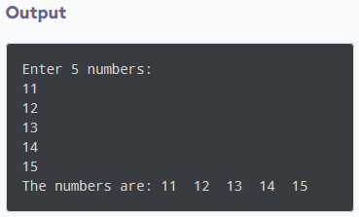
Example 2: Take Inputs from User and Store Them in an Array
#include <iostream>
using namespace std;
int main() {
int numbers[5];
cout << "Enter 5 numbers: " << endl;
// store input from user to array
for (int i = 0; i < 5; ++i) {
cin >> numbers[i];
}
cout << "The numbers are: ";
// print array elements
for (int n = 0; n < 5; ++n) {
cout << numbers[n] << " ";
}
return 0;
}

Slide 17
Example 3: Display Sum and Average of Array Elements Using for Loop
#include <iostream>
using namespace std;
int main() {
// initialize an array without specifying size
double numbers[] = {7, 5, 6, 12, 35, 27};
double sum = 0;
double count = 0;
double average;
cout << "The numbers are: ";
}

Slide 18
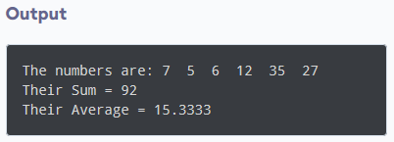
Example 3: Display Sum and Average of Array Elements Using for Loop
// print array elements
// use of range-based for loop
for (int i=0 ;i<= n; i++) {
cout << numbers [i] << " ";
// calculate the sum
sum += numbers [i];
// count the no. of array elements
++count;
}
// print the sum
cout << "\nTheir Sum = " << sum << endl;
// find the average
average = sum / count;
cout << "Their Average = " << average << endl;
return 0;
}

Slide 19

Multi-Dimensional Arrays

Slide 20
Two-Dimensional Arrays
A Two-dimensional array is an array consists of number of Rows and Columns.
To declare a Two-dimensional array,
Define the variable type,
Specify the name of the array
Specify the number of Rows and Columns of array in square brackets :
string letters[2][4];

Slide 21
Two-Dimensional Array
As with ordinary arrays, you can insert values with an array literal - a comma-separated list inside curly braces.
In a multi-dimensional array, each element in an array literal is another array literal.
string letters[2][4] = { { "A", "B", "C", "D" }, { "E", "F", "G", "H" } };
Initialization of two-dimensional array
int test[2][3] = {2, 4, 5, 9, 0, 19};
int test[2][3] = { {2, 4, 5}, {9, 0, 19}};
This array has 2 rows and 3 columns,
A | B | C | D
E | F | G | H
Two dimensions

Slide 22
Loop Through a Multi-Dimensional Array
To loop through a multi-dimensional array, you need one loop for each of the array's dimensions.
The following example outputs all elements in the letters array:
Example:
string letters[2][4] = { { "A", "B", "C", "D" }, { "E", "F", "G", "H" } }; for(int i = 0; i < 2; i++) { for(int j = 0; j < 4; j++) { cout << letters[i][j] << "\n"; } }

Slide 23
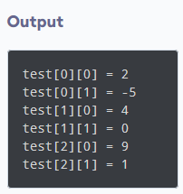
Example
// C++ Program to display all elements
// of an initialised two dimensional array
#include <iostream>
using namespace std;
int main() {
int test[3][2] = {{2, -5},
{4, 0},
{9, 1}};
// use of nested for loop
// access rows of the array
for (int i = 0; i < 3; ++i) {
// access columns of the array
for (int j = 0; j < 2; ++j) {
cout << "test[" << i << "][" << j << "] = " << test[i][j] << endl;
}
}
return 0;
}

Slide 24
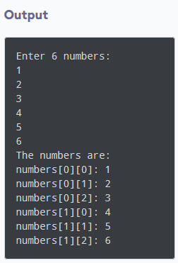
Example
Taking Input for Two Dimensional Array
#include <iostream>
using namespace std;
int main() {
int numbers[2][3];
cout << "Enter 6 numbers: " << endl;
// Storing user input in the array
for (int i = 0; i < 2; ++i) {
for (int j = 0; j < 3; ++j) {
cin >> numbers[i][j]; }
}
cout << "The numbers are: " << endl;
// Printing array elements
for (int i = 0; i < 2; ++i) {
for (int j = 0; j < 3; ++j) {
cout << "numbers[" << i << "][" << j << "]: " << numbers[i][j] << endl; }
}
return 0;
}

Slide 25



